Slide 1
Assignment 1
Assignment 4

Slide 2
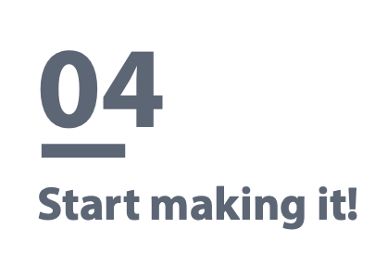
Assignment 4: Start making it! - Prototype and Project Plan
* There are 6 parts in this assignment.
Part 1: Project Idea
Team Members | Vincent, Sammul, Jaga, Jaehee, Farrell
Project POV | PG TA in HKUST need a way to conveniently answer questions by UG students outside of class because there are multiple platforms students use to ask their questions outside tutorials.
Project Idea | Come up with a GenAI tool that is linked to an FAQ database, allowing students to refer their questions there instead of asking PG TA for most of their questions.

Slide 3
Assignment 4: Start making it! - Prototype and Project Plan
Part 2a: Prototype - Build
Set the goal and scenario: WHO are you designing for?
PG TA: They are the ones who answer many of the UG students' questions outside of lectures/tutorials.
Scenario for PG TA: Outside of office hours, when they are answering questions by UG students in online platforms
UG Students: They are the ones who ask the questions towards the PG TA outside of lectures/tutorials
Scenario for UG students: Outside of class time, studying for exams; working on assignments/revision
WHAT unmet need do they have?
•PG TA: They need to work on their researches but they don't have enough time to do so. This is because PG TA have many other tasks, with answering UG students' questions being one of the most time-consuming duties. Answering students is so time-consuming because there are many questions in different platforms, so there are both platform-switching time and time for answering questions. However, because there is no centralized platform and questions are not organized, PG TA are answering each question independently without an organized system. With the busy schedule, they need an efficient way to answer most students' questions without repeating themselves.
•UG Students: They want to study for their exams conveniently and reliably but they currently can't do both. The two major ways UG students adopt to solve their questions are through asking GenAI and asking PG TA. However, the former method sometimes produces unreliable or even false answers which is problematic for preparing exams, while the latter one is limited to office hours and deemed to be inconvenient by many. Currently, there are no easily accessible methods for UG students to get reliable assistance for exams conveniently, so they have a need for academic assistance which is both convenient and reliable.

Slide 4
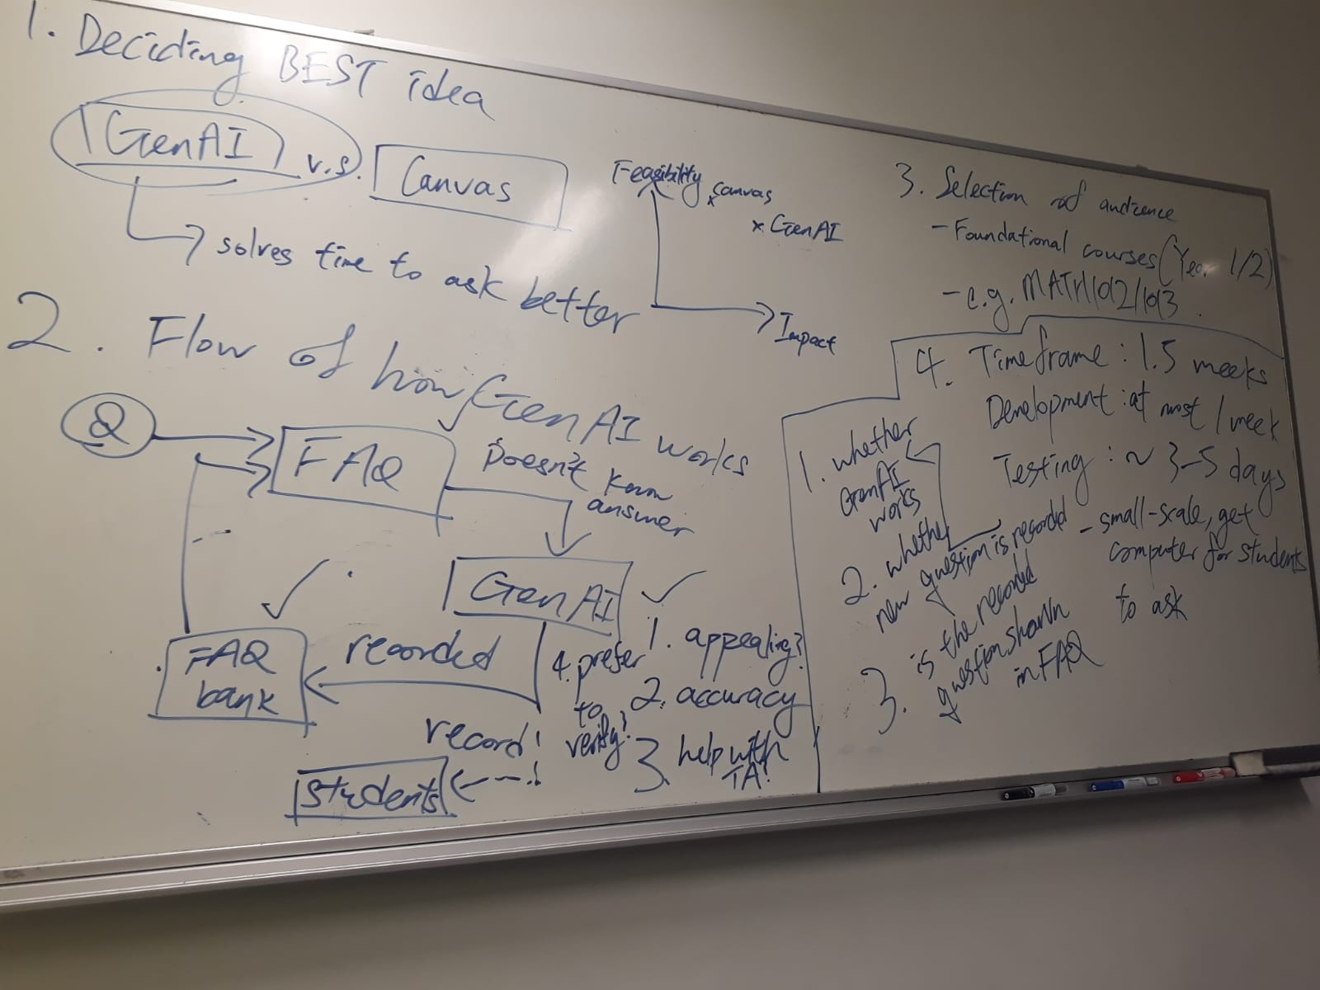
Assignment 4: Start making it! - Prototype and Project Plan
Part 2b: Summary
Use whatever raw materials you have and take a couple of hours to quickly build a rough prototype. Write down your building process and take photos/videos for your prototype.
Tips: Don’t spend too much time and seek perfection for your prototype. The main purpose is to make your idea tangible and testable for your audience. The first few prototypes are designed to fail (so you learn how you can improve)
Building Process: We have first identified the core functionalities we want to achieve based on the unmet needs and our brainstorming session. The concepts we want to test are:
FAQ database which can be verified by PG TA
GenAI that are limited to only giving tips and assistance
but not direct answers
Summary of questions asked in GenAI for TA to update FAQ
We have also decided the idea to be named “T-AI”.
Figure 1: Our summary of meeting on 26th October, 2023

Slide 5
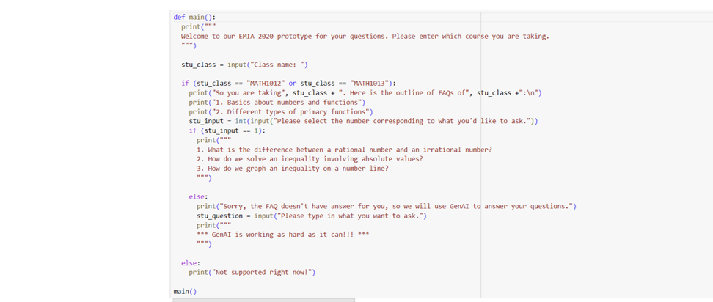
Assignment 4: Start making it! - Prototype and Project Plan
Part 2b: Summary
Use whatever raw materials you have and take a couple of hours to quickly build a rough prototype. Write down your building process and take photos/videos for your prototype.
Tips: Don’t spend too much time and seek perfection for your prototype. The main purpose is to make your idea tangible and testable for your audience. The first few prototypes are designed to fail (so you learn how you can improve)
With our core concepts to be tested, we have produced a draft to illustrate the logic flow in our first prototype:
Type in course name
Show the course outline of the specified course
Show FAQ for the specified topic
Switch to GenAI if FAQ doesn't answer users' questions
Figure 2: Our draft to show the logic flow of our concepts

Slide 6
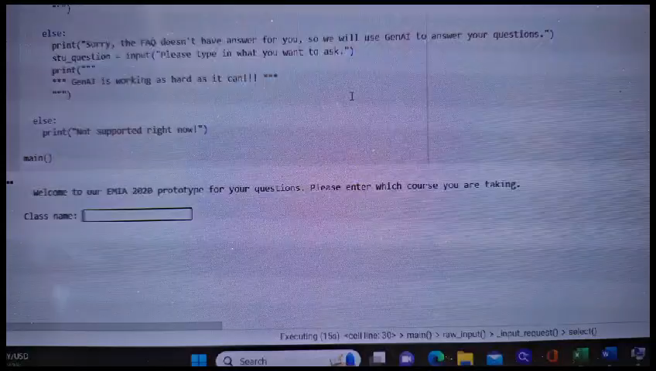
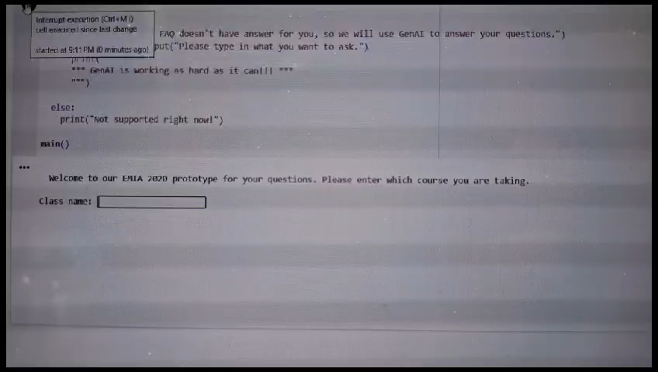
Assignment 4: Start making it! - Prototype and Project Plan
Part 2b: Summary
Use whatever raw materials you have and take a couple of hours to quickly build a rough prototype. Write down your building process and take photos/videos for your prototype.
Tips: Don’t spend too much time and seek perfection for your prototype. The main purpose is to make your idea tangible and testable for your audience. The first few prototypes are designed to fail (so you learn how you can improve)
When FAQ includes the questions, users can directly take reference
2. When FAQ doesn't include the questions, users can then ask GenAI
Video 1: Our idea of FAQ outline
Video 2: Our idea of GenAI

Slide 7
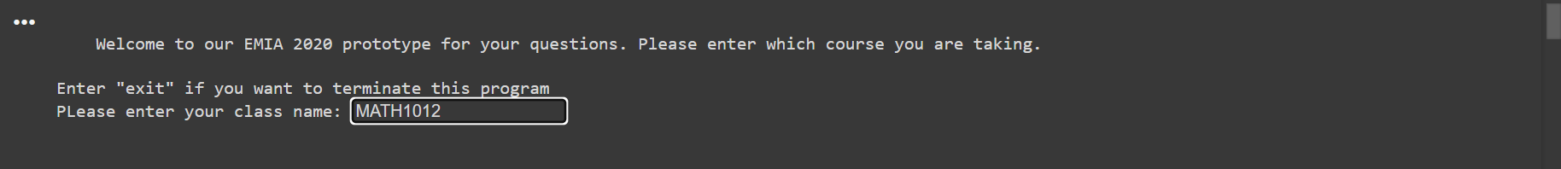
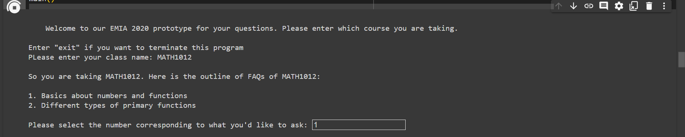
Assignment 4: Start making it! - Prototype and Project Plan
Prototype Flow Showcase
With the flow in mind, we have then made a concept prototype showing the essential functions of our GenAI tool
Fig. 3: Prompt the user to enter the class name
Fig. 4: Prompt the user to enter the chapter number

Slide 8
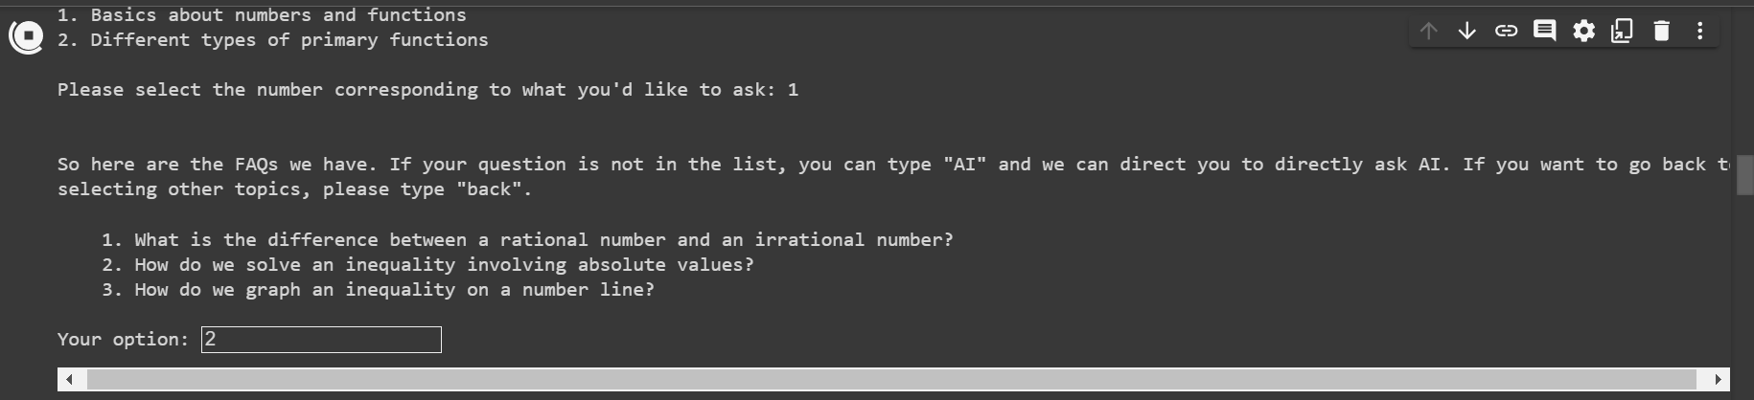
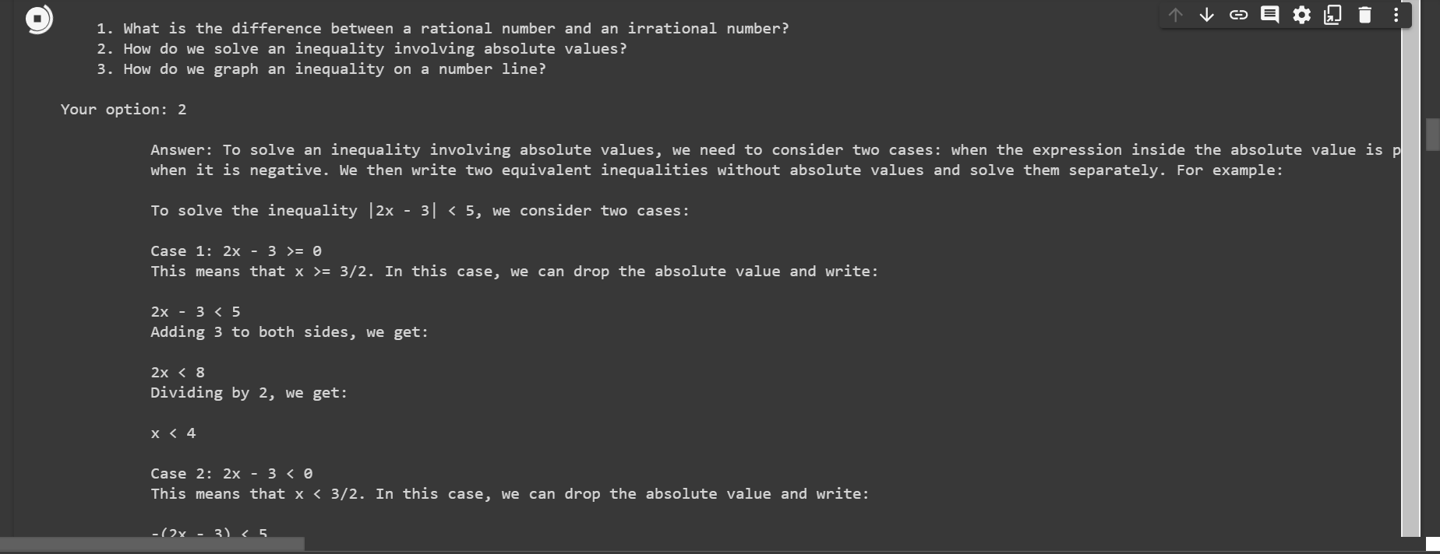
Assignment 4: Start making it! - Prototype and Project Plan
Fig. 5: Prompt the user to enter the FAQ number
Fig. 6: The answer to the selected question

Slide 9
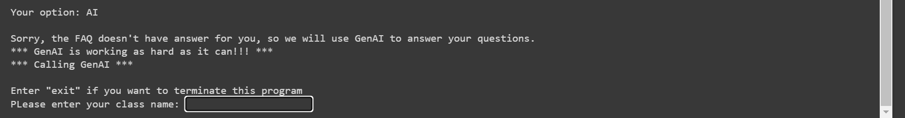
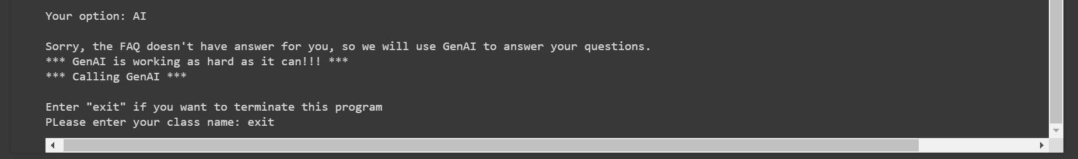
Assignment 4: Start making it! - Prototype and Project Plan
Fig. 7: Allowing users to use our GenAI to ask questions
Fig. 8: The exit feature

Slide 10
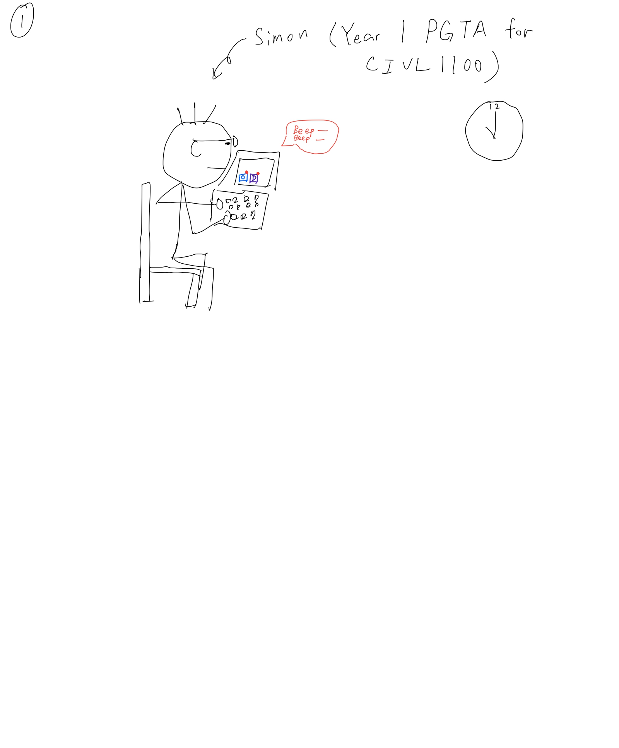
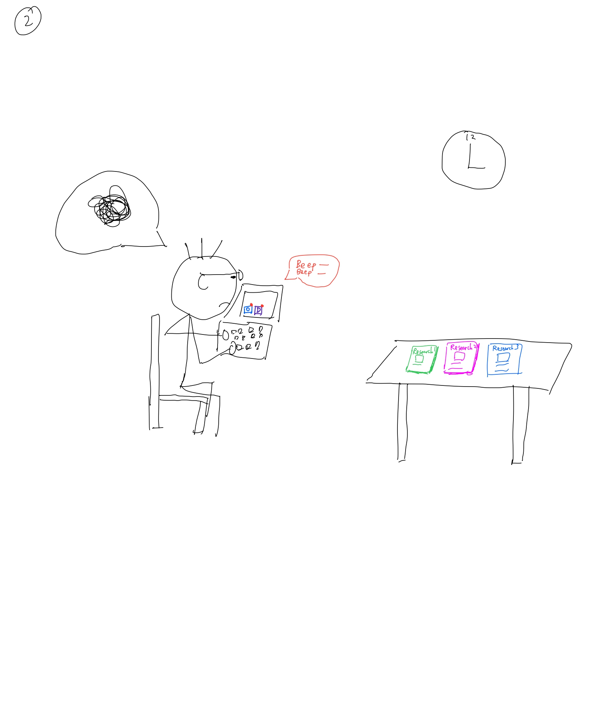
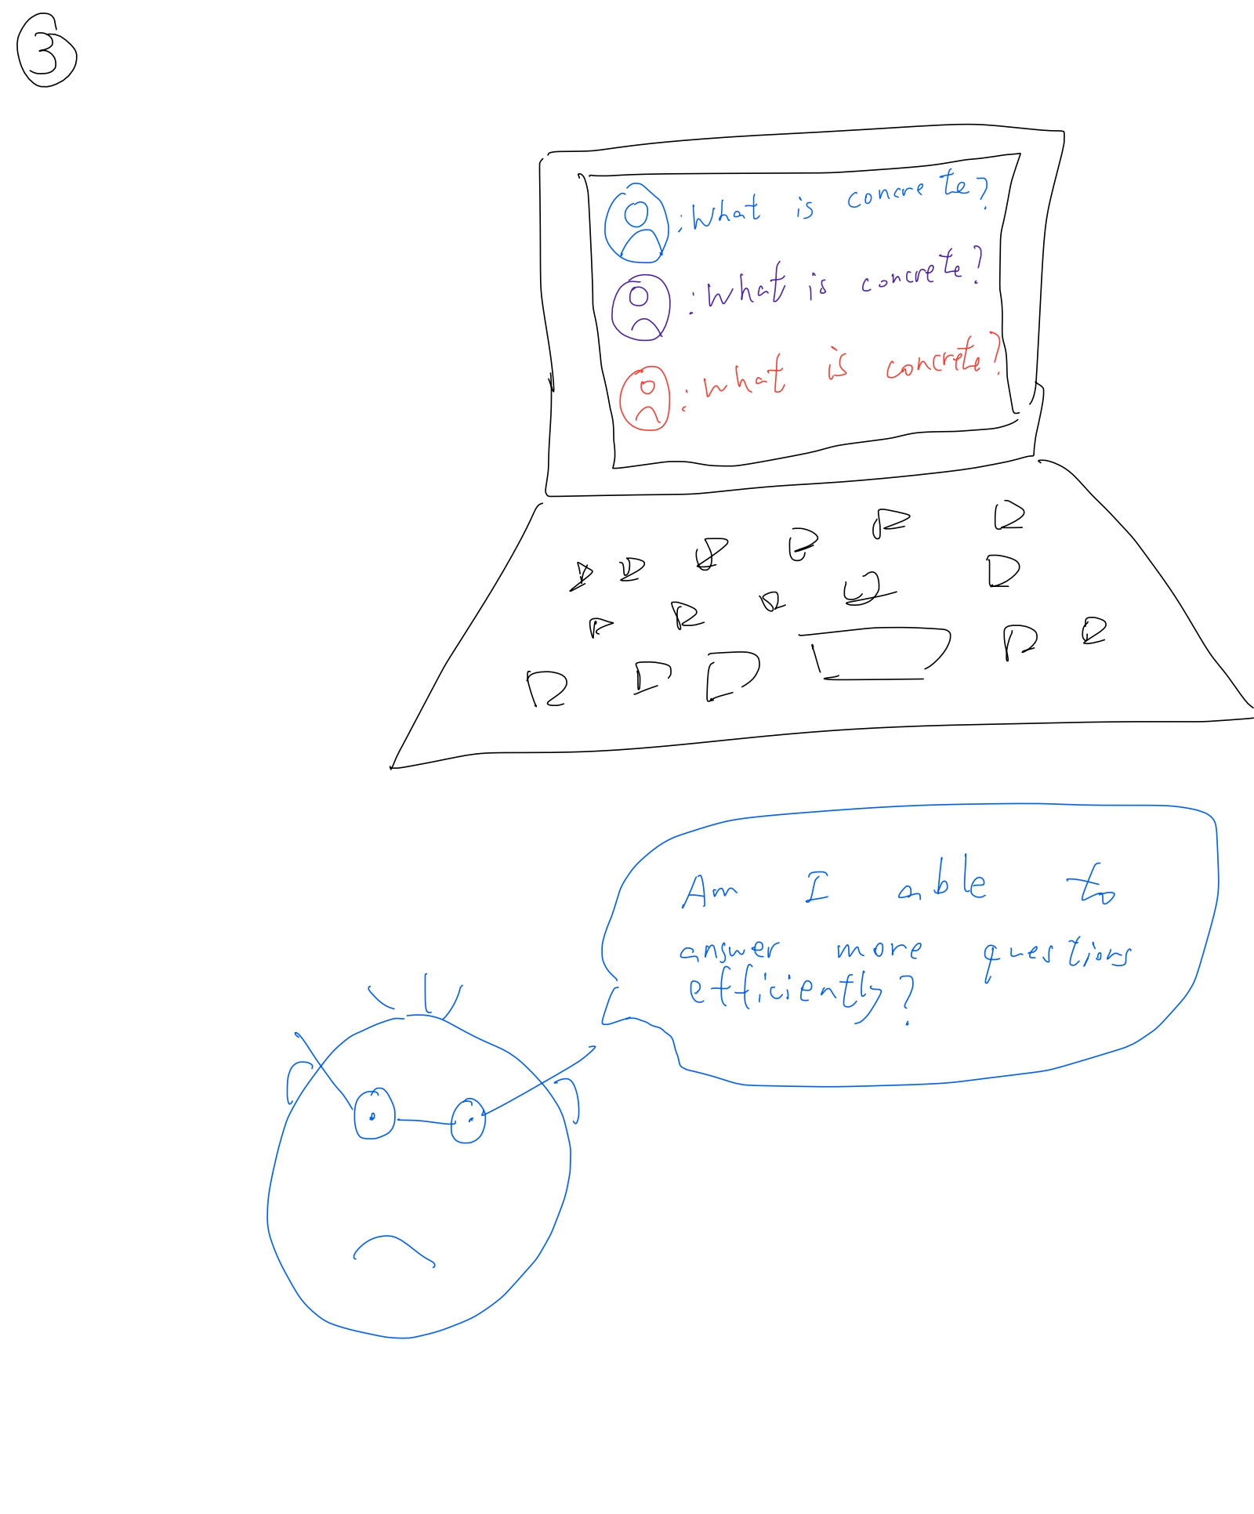
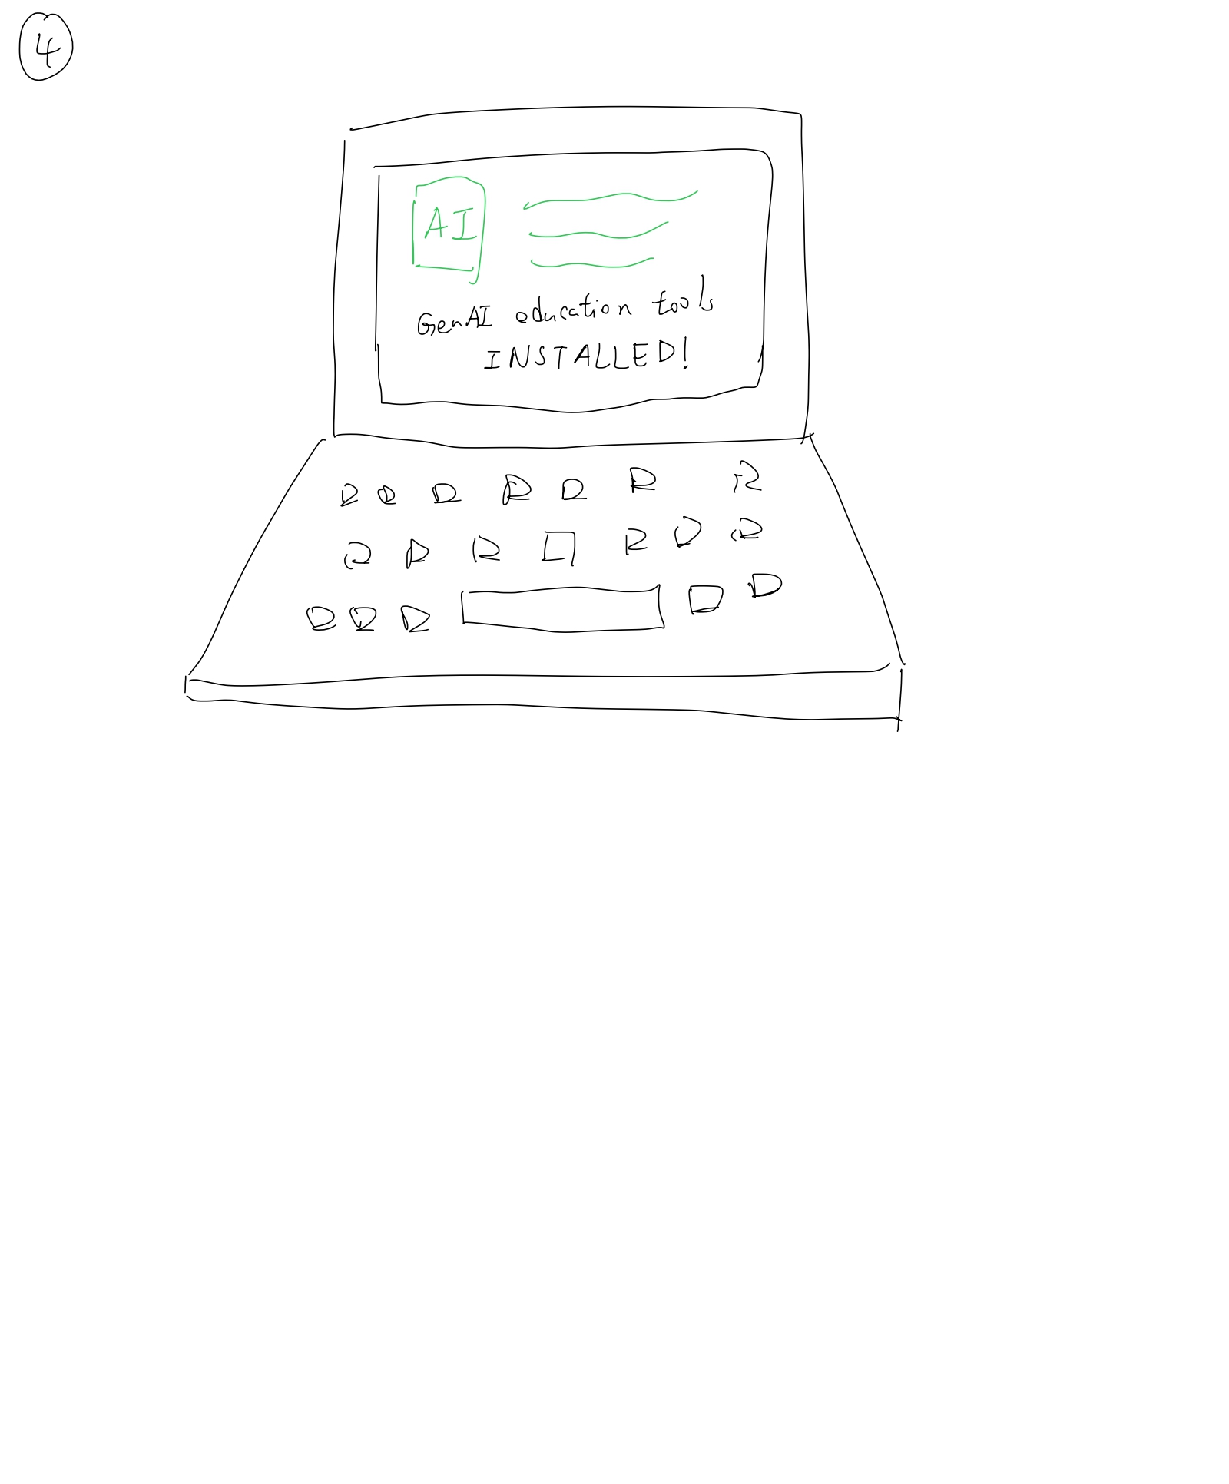
Assignment 4: Start making it! - Prototype and Project Plan
Part 2c: Story board
Storyboard for PG TA
1. Simon, a Year 1 PG in CIVL major, has to serve as a TA in CIVL 1100. He has received lots of questions in platforms like Outlook and Discord.
2. Simon was frustrated that he hasn't finished answering all the questions for over an hour, and worried that he won't have time for research.
3. Simon finds that most questions are either repeated or have been mentioned in class, and wonder if he can answer them more efficiently.
4. Simon then decided to install "T-AI" in the canvas page of CIVL 1100, hoping that this will help him with answering questions.

Slide 11
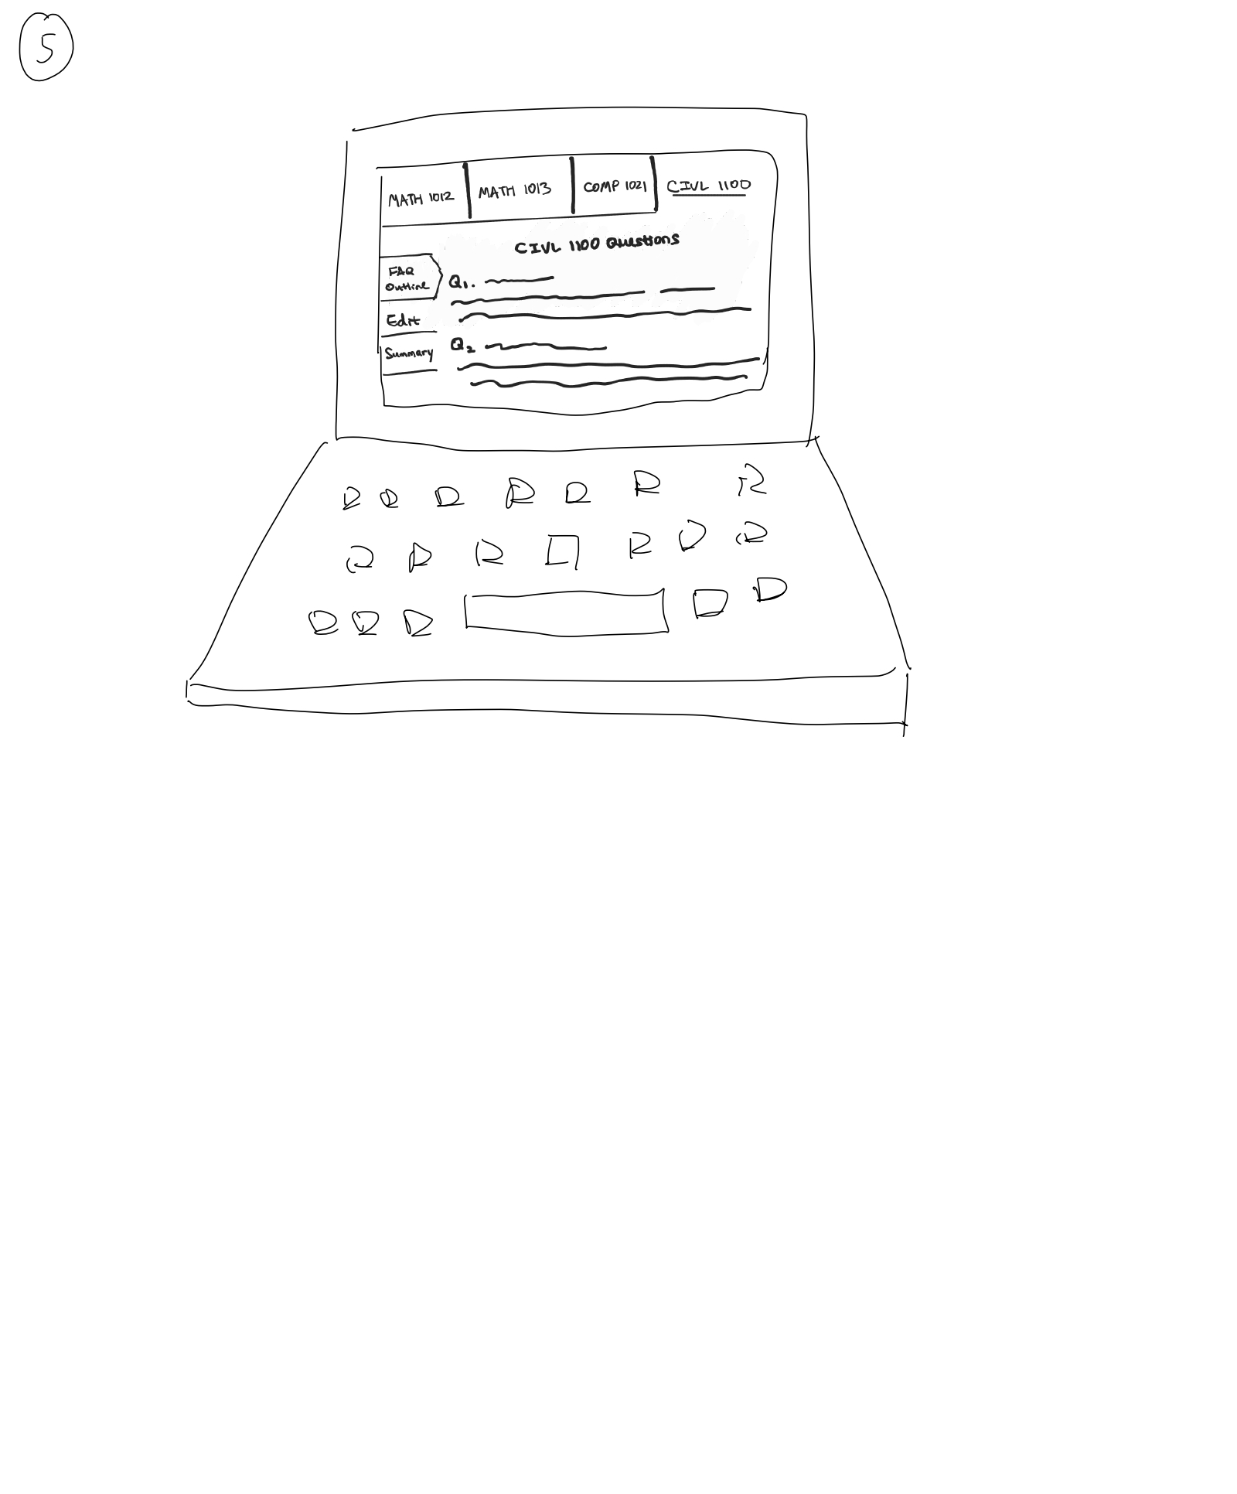
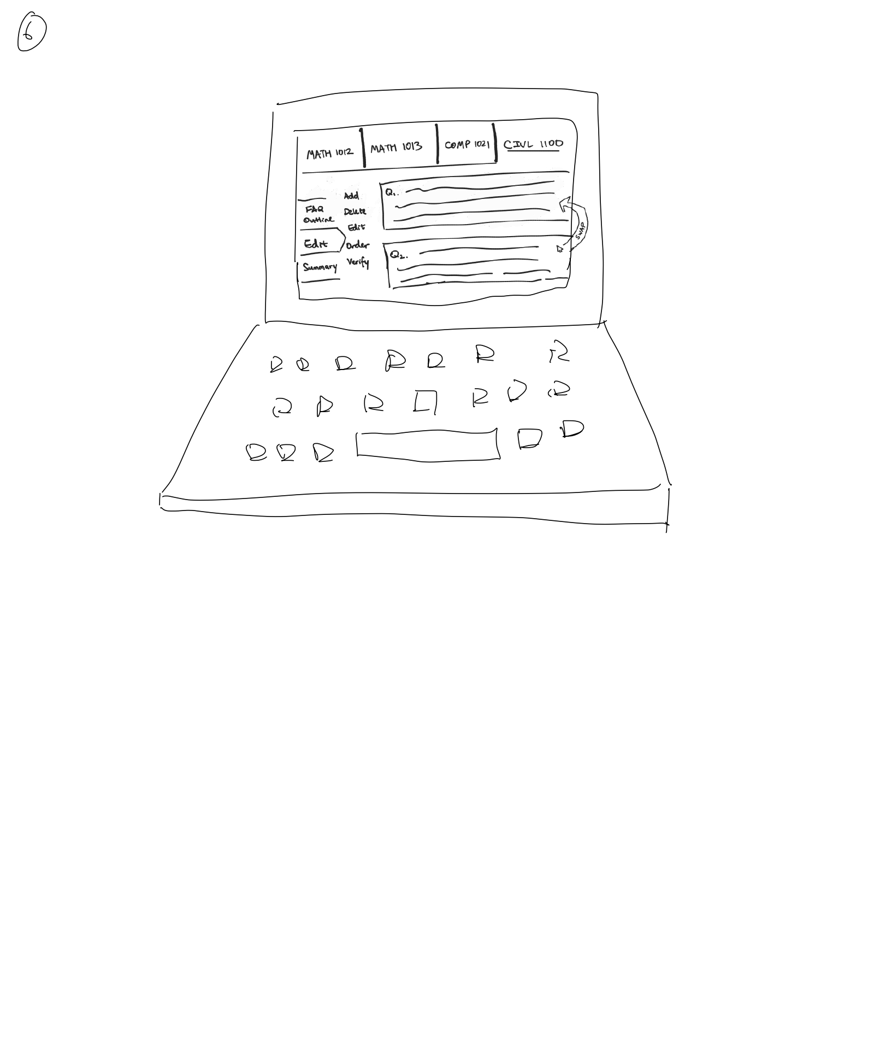
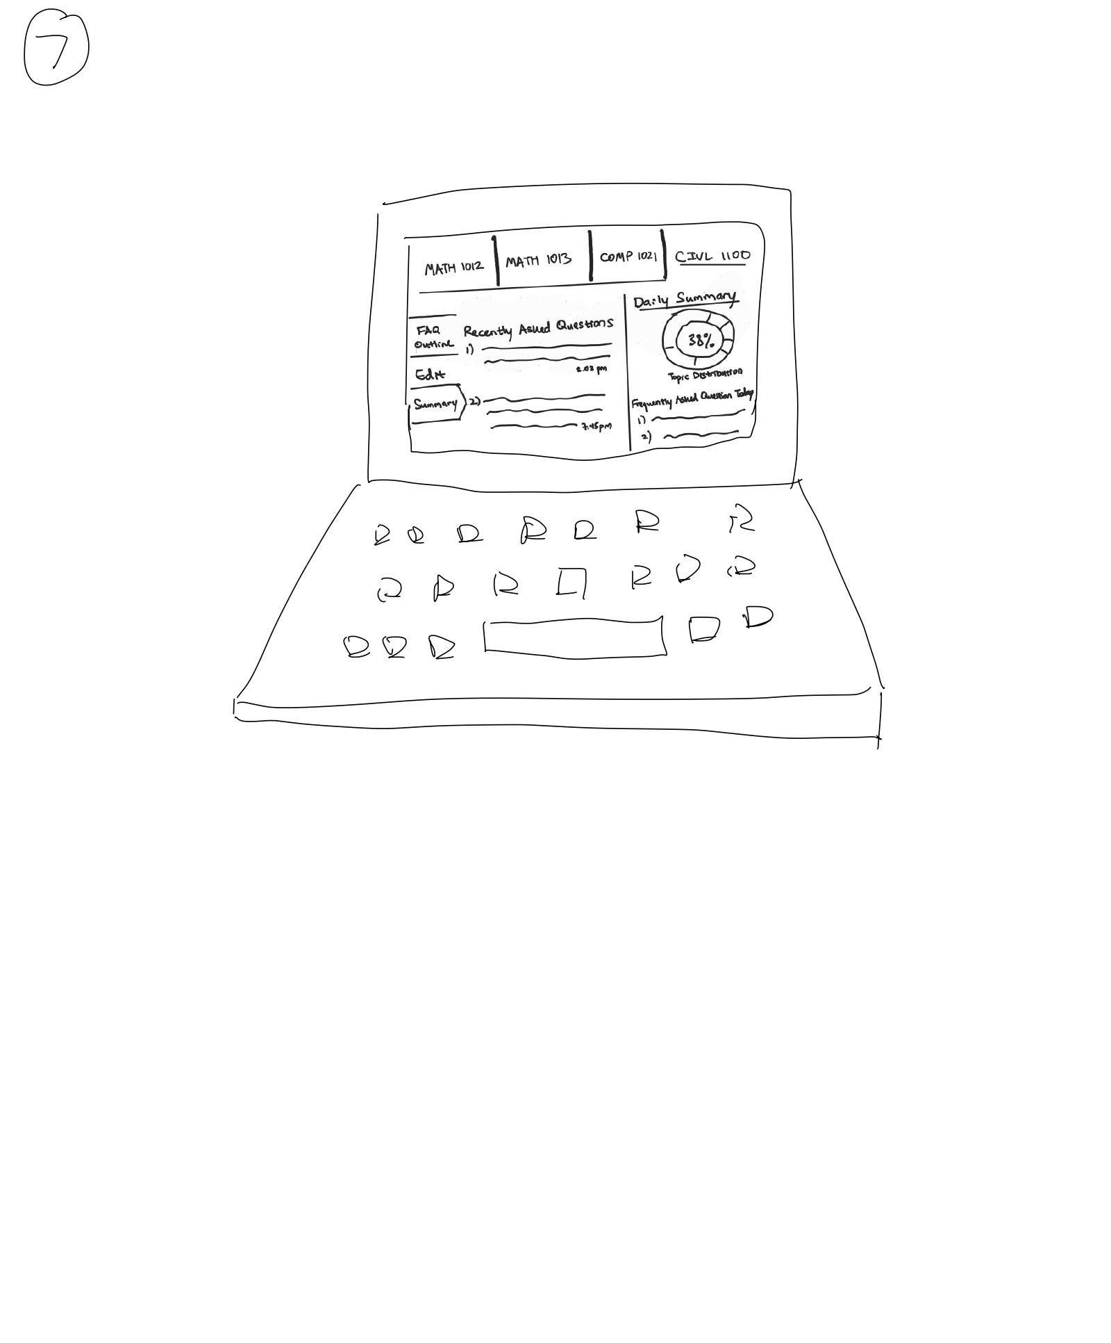
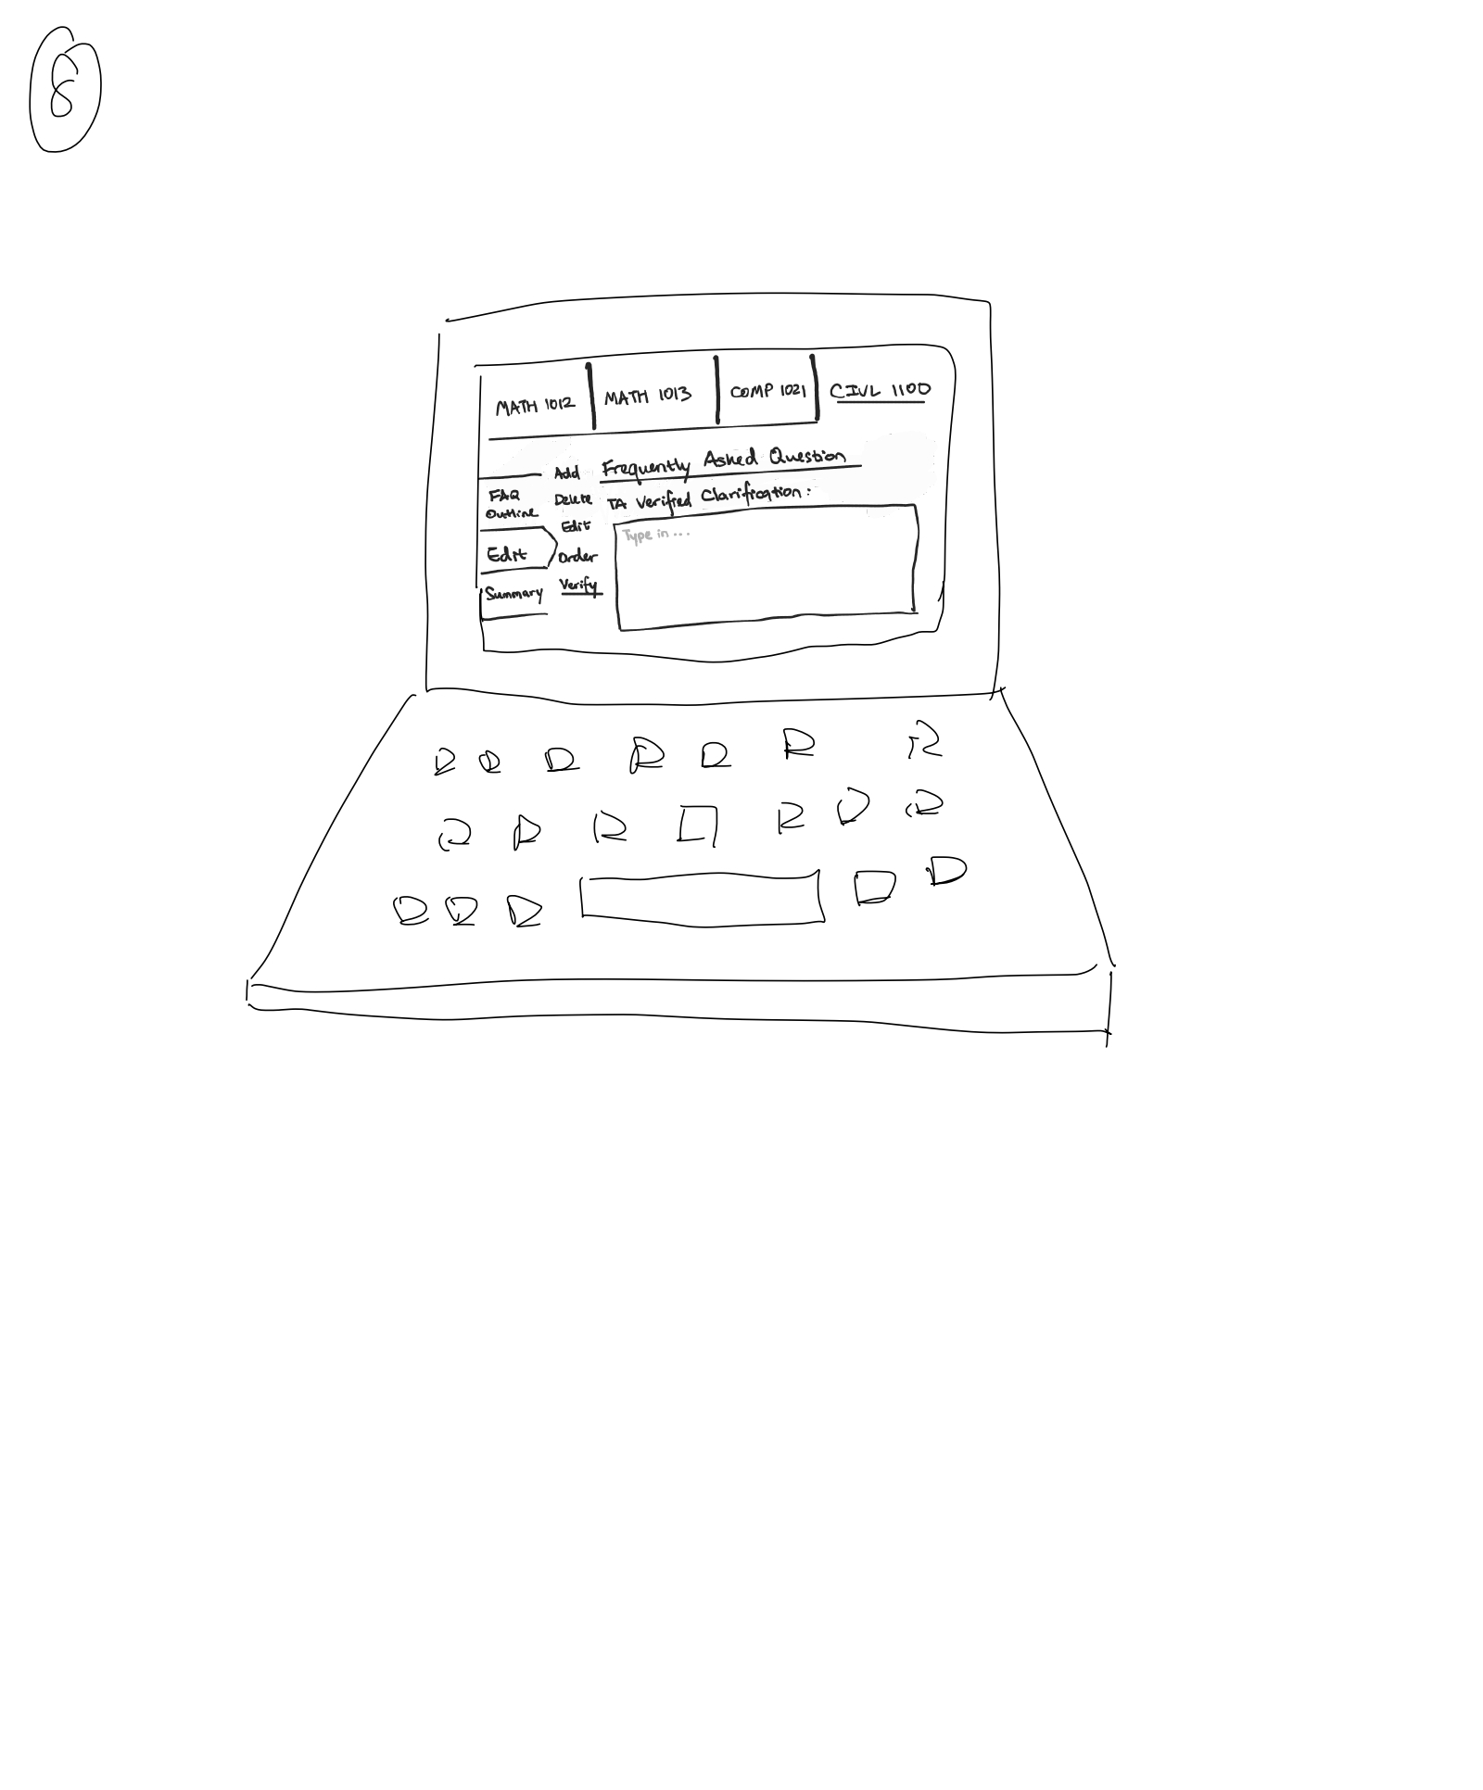
Assignment 4: Start making it! - Prototype and Project Plan
Part 2c: Story board
Storyboard for PG TA
5. Upon clicking into "T-AI", Simon was directed to a pre-built outline and FAQs for students.
6. Simon can add, edit, delete and change the order of outline and FAQs by simple drag-and-click.
7. Simon also sees the questions asked by students in "T-AI", as well as a daily summary of most frequently asked questions.
8. Instead of answering individual questions, Simon can now edit on "T-AI" for all students in CIVL 1100 to check.

Slide 12
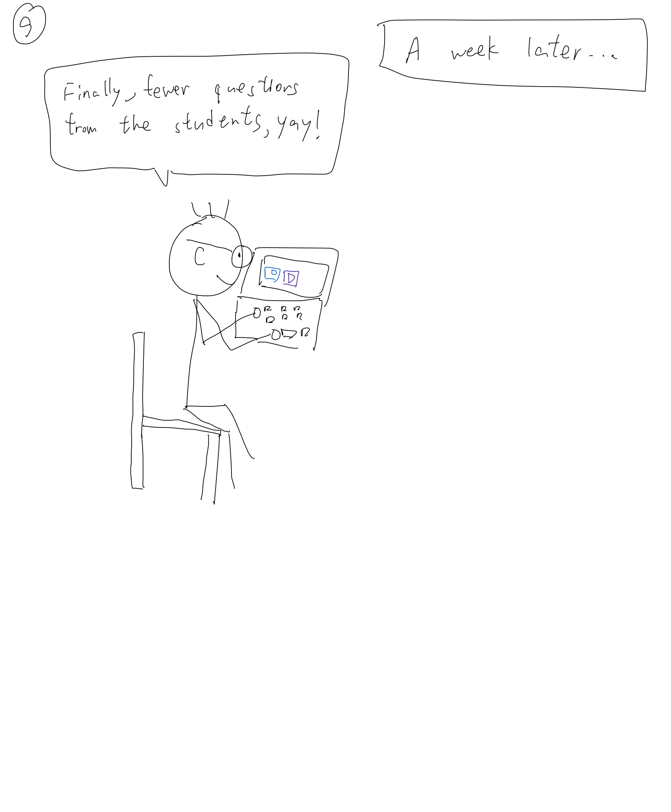
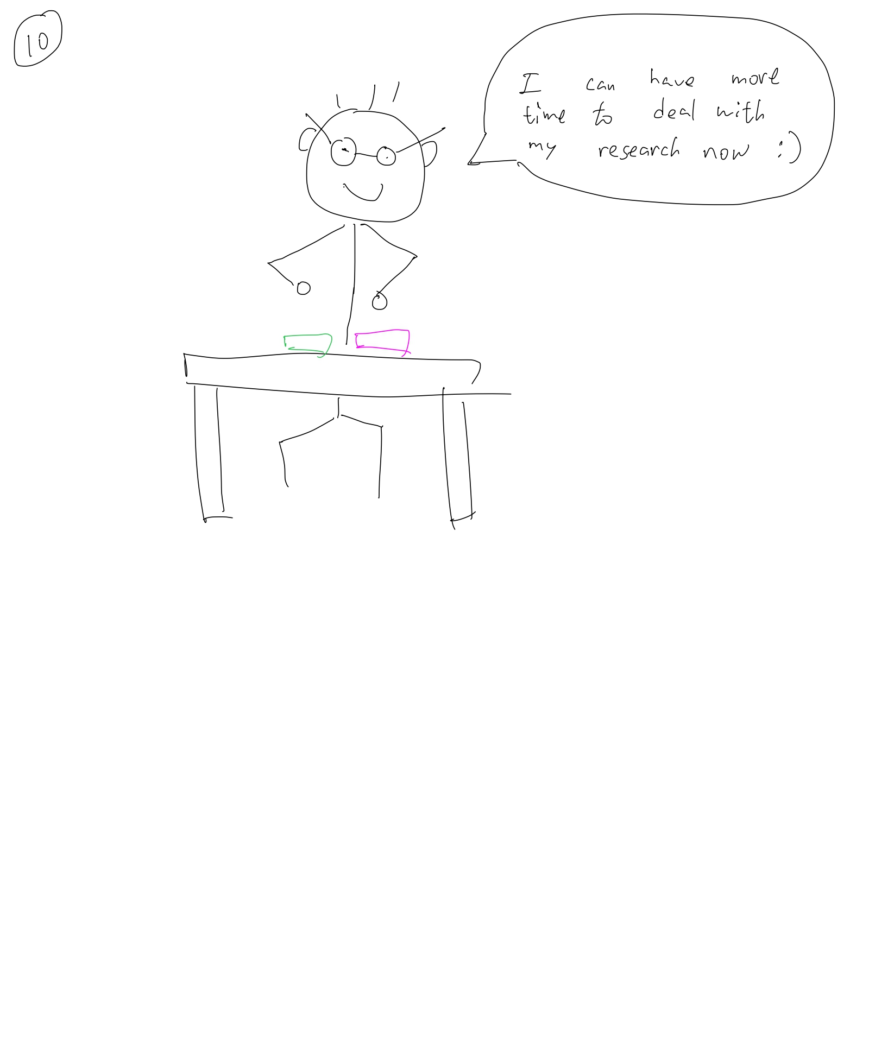
Assignment 4: Start making it! - Prototype and Project Plan
Part 2c: Story board
Storyboard for PG TA
9. After a week, Simon finds out that he receives less questions and only needs to spend less than 20 minutes for answering questions per day. What's more, he only needs to check "T-AI" once or twice a week for new FAQs.
10. Simon is happy that he can free up more time for his research and other tasks as a PG student.

Slide 13
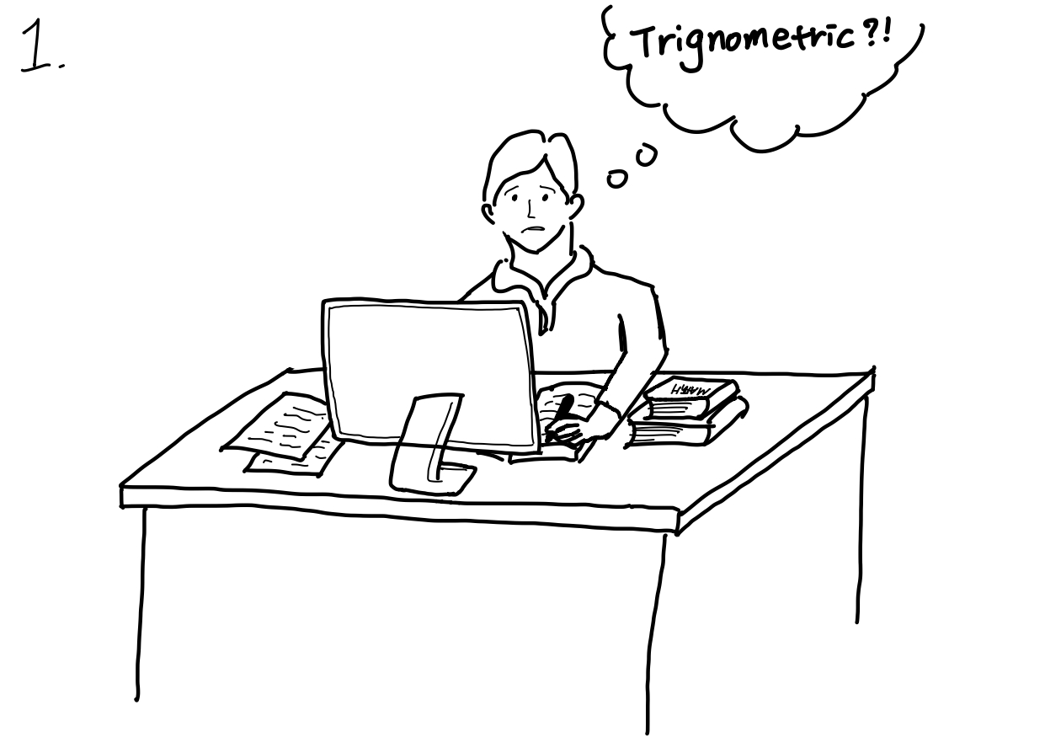
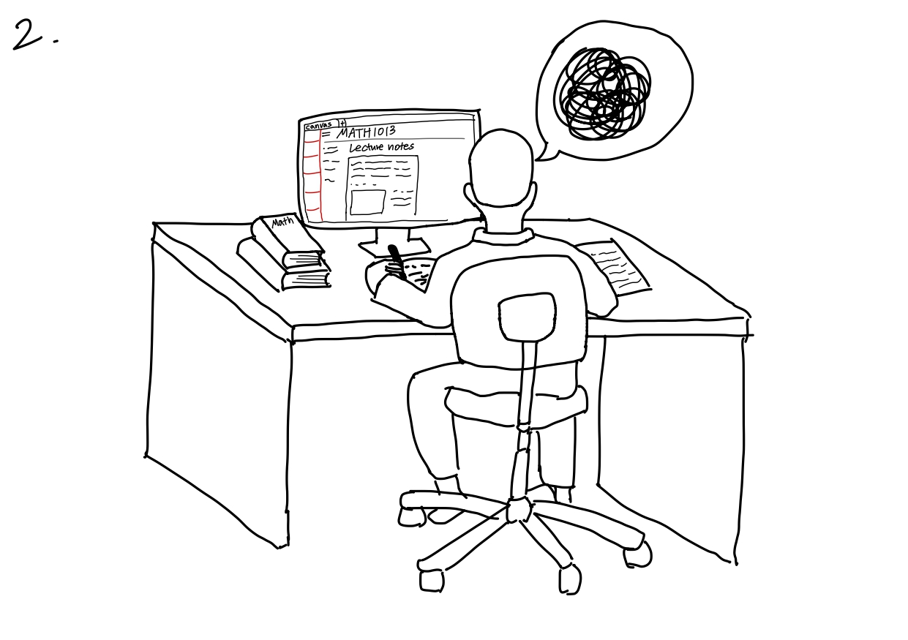
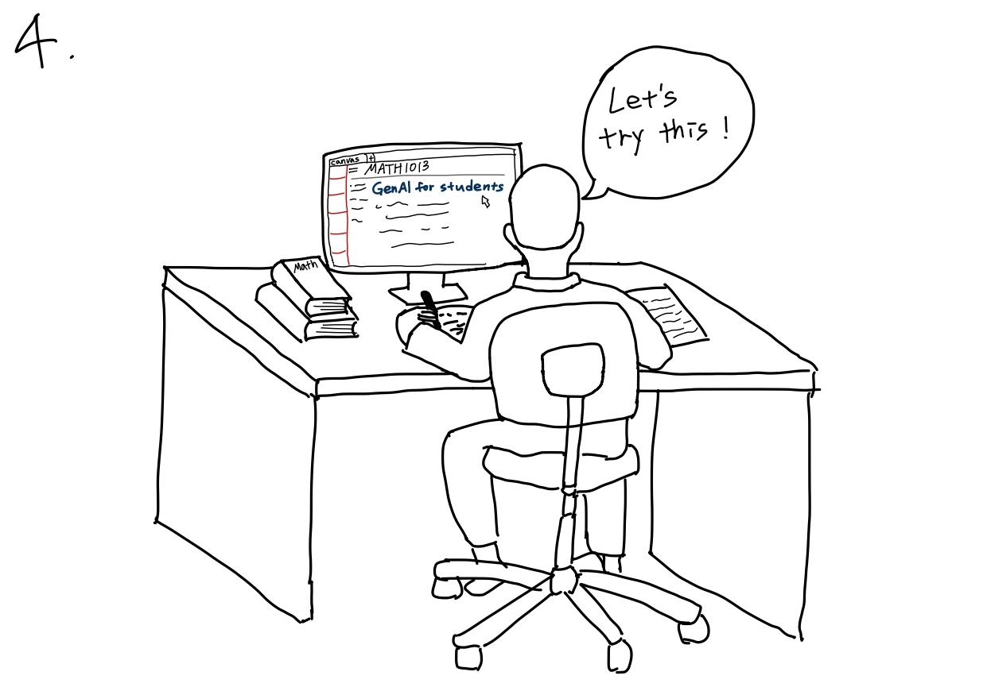
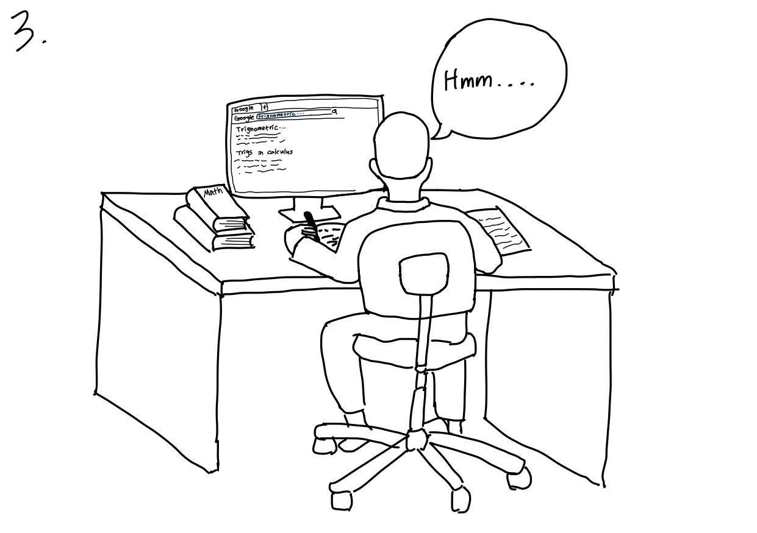
Assignment 4: Start making it! - Prototype and Project Plan
Part 2c: Story board
Storyboard for UG students
1. Jake, a hardworking student, was in his room solving questions in the textbook for his MATH 1013 midterm next week, and he encountered a question about trigonometric that he couldn’t understand.
2. Jake tried looking up the concepts related to the question in his digital lecture notes, but could not find a satisfactory answer or explanation that helped him to understand the question.
3. Jake then also tried searching the question up on the internet, but could not find an accessible nor understandable answer that was specific to his question.
4. Jake then found "T-AI" on his Canvas page, and decided to give it a try.

Slide 14
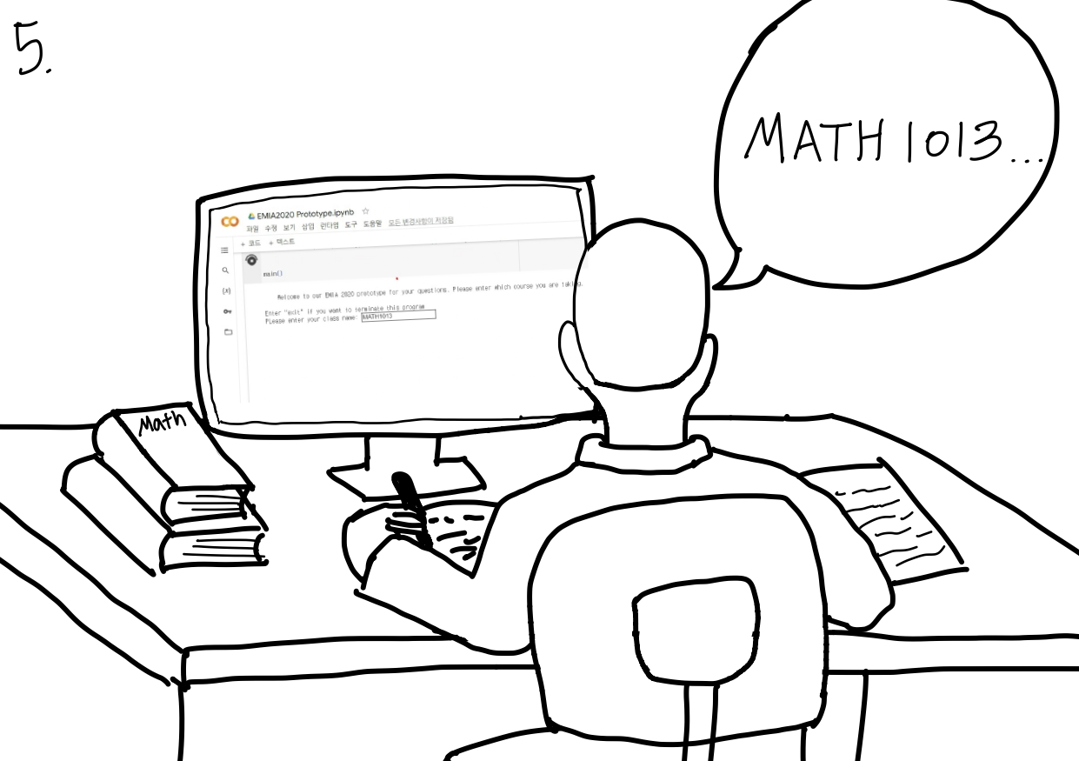
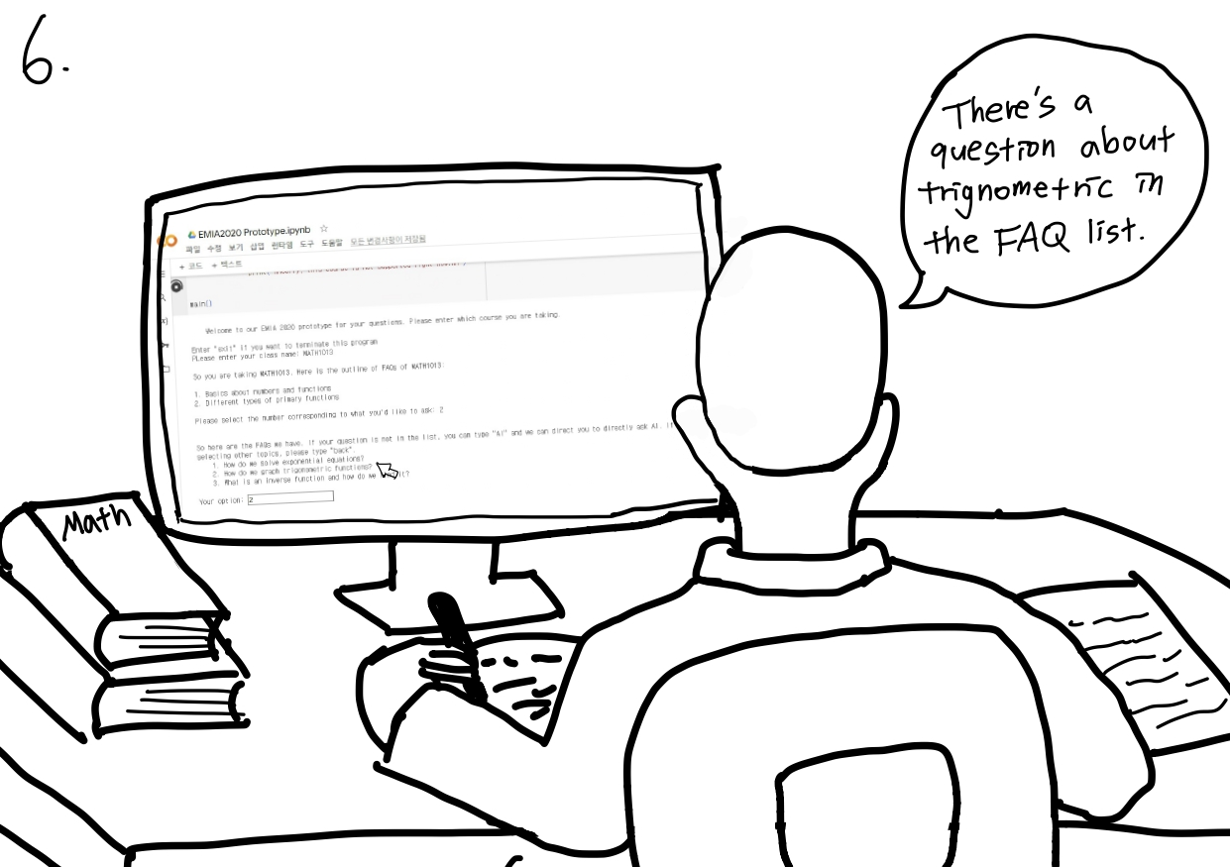
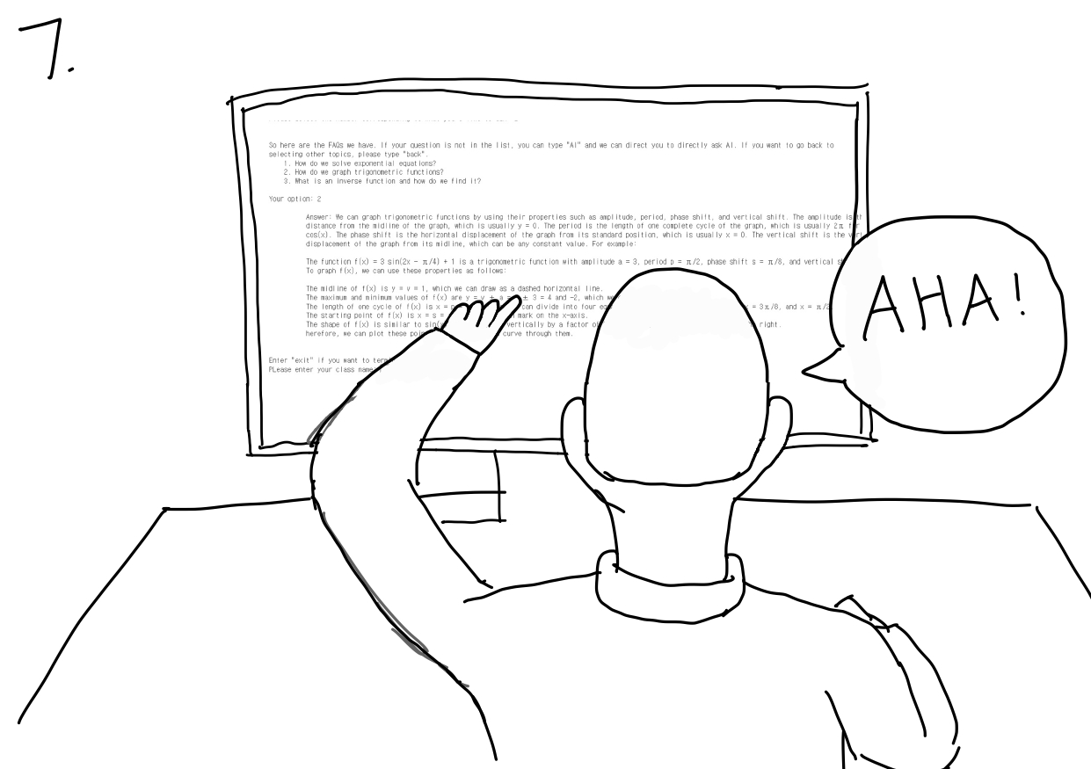
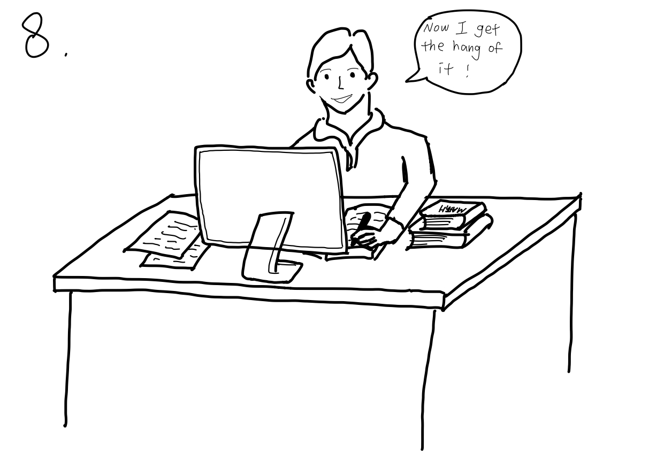
Assignment 4: Start making it! - Prototype and Project Plan
Part 2c: Story board
Storyboard for UG students
5. Jake entered the course he was struggling in, MATH 1013, into "T-AI".
6. Jake was then directed to a list of topics covered in MATH 1013 by "T-AI", and he selected the topic of trigonometric.
7. Jake then saw a concise list of frequently asked questions (FAQs) related to trigonometric that were all very clear in description, and scrolled through to find a question similar to his.
8. Jake could find a question that has similar concepts to his question which cleared up his confusion, so he could solve the question by himself.

Slide 15
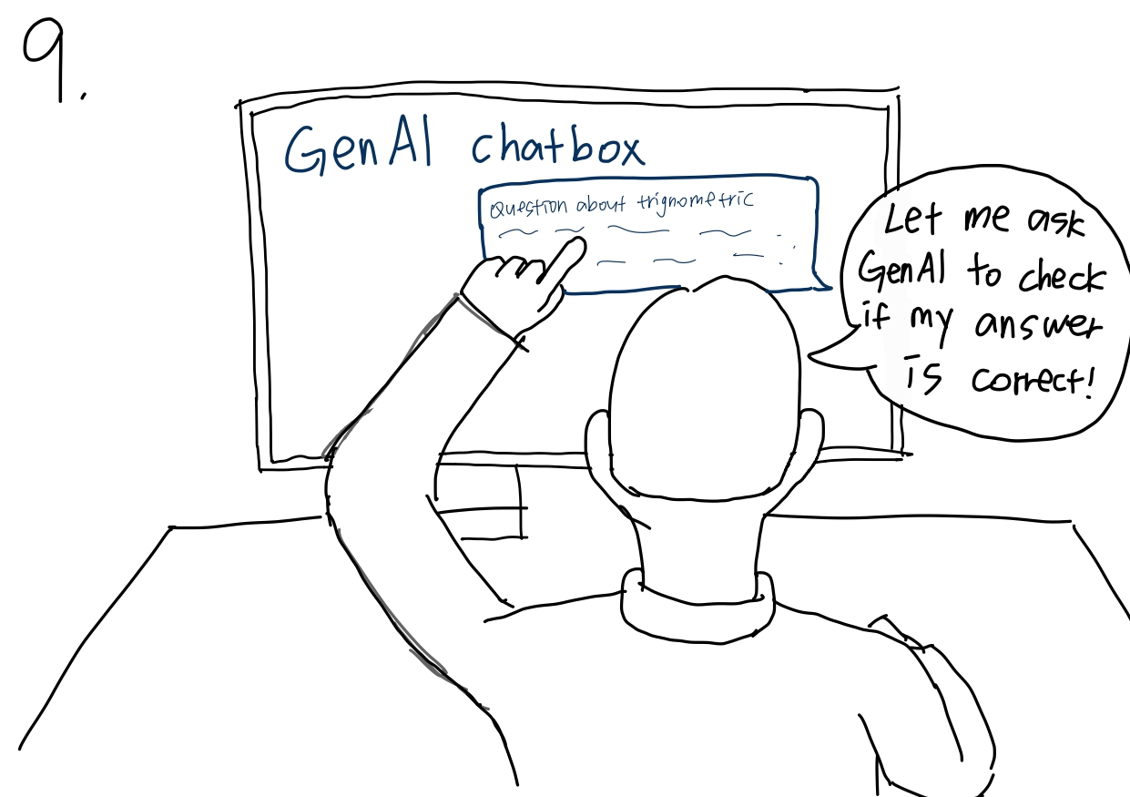
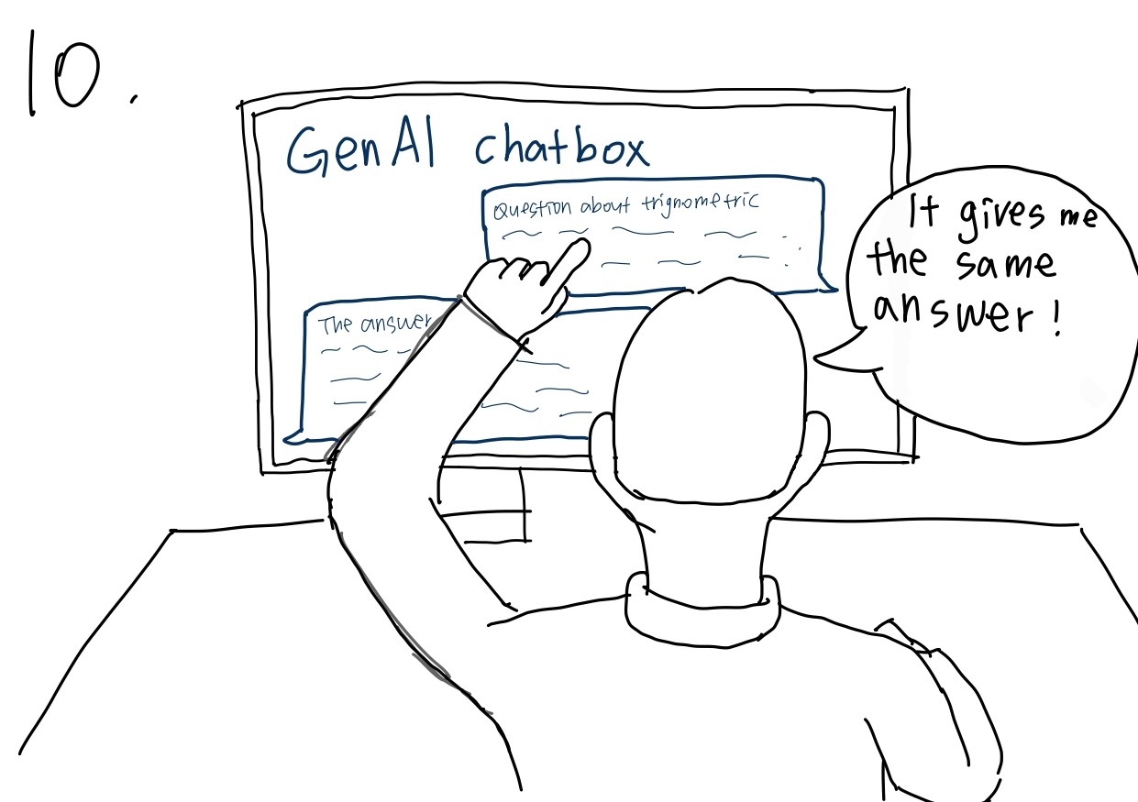
Assignment 4: Start making it! - Prototype and Project Plan
Part 2c: Story board
Storyboard for UG students
9. After Jake solved the problem, he wanted to confirm that his answer is correct. So he entered a question about trigonometric into 'T-AI" textbox, to check whether it would produce the same answer as him.
10. "T-AI" then produces an answer using GenAI which reaffirms Jake’s answer and understanding to be correct.

Slide 16
Assignment 4: Start making it! - Prototype and Project Plan
Part 3: Test your prototype with users and get feedback
Bring your prototype to 1~3 people and share your idea with them. Write down your step-by-step testing procedure below:
We shall test our prototype by face-to-face. We will find 3-5 target users, which should include both PG TA and undergraduate students in HKUST who have taken fundamental courses (e.g. MATH1012/1013, COMP1021). In order to find them, we intentionally select the time when MATH1012 or MATH1013 lectures/tutorials end and go to those classrooms and lecture theatres and ask some of the students to test the prototype. For each interviewee, the process flow is done as below.
Run the prototype in Google Colaboratory, and then without providing any spoken instructions and hints to the user, allow them to freely try and use our prototype
In case they miss some of the features or something not understand, we can give minimal hints and instructions for them to test them out
Ask the user about anything or any features or function that is not good enough, and also ask for their suggestions on how we can improve that
Ask the user about the things we have did quite well in the prototype
Ask the user about what features that are not inside this prototype do they want in our final product
Ask for the user preference on the type of interface that they like, including the design and color usage

Slide 17
Assignment 4: Start making it! - Prototype and Project Plan
Part 3: Test your prototype with users and get feedback
Before you start testing, please think about: what do you want to learn with your prototype? What questions do you have? What information do you want to collect? (continue)
Things that we want to learn with our prototype:
Whether users find FAQ feature appealing and desirable
Whether users find the GenAI provided helpful and accurate
Whether users prefer our idea over using ChatGPT and asking PG TA
Whether PG TA specifically think that our idea can save their time
Questions that we have:
What do the users think of the quality of the answers of the FAQ lists?
Do the users think the flow of the prototype is reasonable?
Do the users really want the AI feature?
What do the users think about the presentation format of the answers
What additional features do the users want in our product?
What kinds of interface do the users want for our product?
What do the users think of the design of the font/words?
Information that we want to collect:
Whether the answers of the FAQ lists are clear to solve the users’ questions
Possible ways to improve the quality of the answers of the FAQ lists
What presentation formats of the answers the users want
Any additional features the user want
User preference on the design of the interface
User preference on the color of the font, background in case they prefer GUI

Slide 18
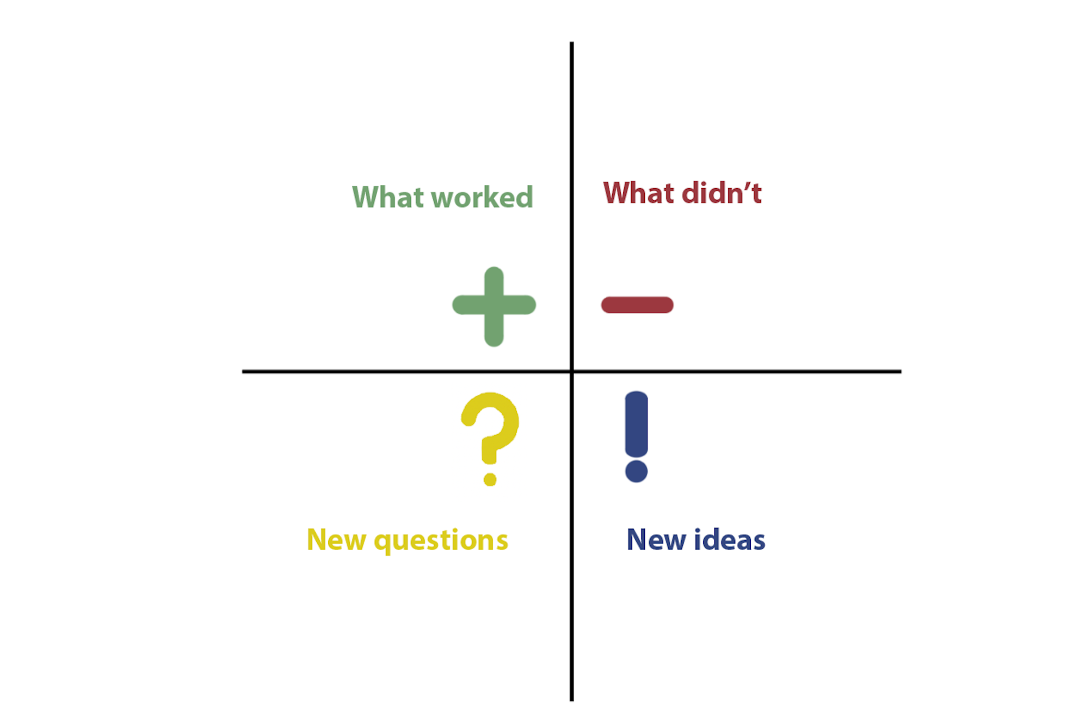
Assignment 4: Start making it! - Prototype and Project Plan
Part 4: Reflection
What feedback did you get from your users? What did you learn about your first prototype? Which parts work and which parts don’t work? And what’s your plan for your next prototype? Fill the matrix of test findings.
We have interviewed 4 Year 1 – Year 3 students who have taken MATH1012/1013 and a PG TA in EMIA to try out our first prototype. Their feedback is summarized below:
Very limited FAQ and outline
Answers too long
Prefer GUI over text interface
Only covered broad topics but not detailed enough
Prompt instructions not clear
Not enough examples
Appreciate good intention
Finds course-specific GenAI more desirable than current options
No need VPN
How to improve users' experience in reading answers?
How to make the user interface more user-friendly and intuitive?
How do we improve the navigation process to be less repetitive and with better context?
How detailed should our FAQ outlines be?
What should our GUI look like?
Using GUI to make the process intuitive and user-friendly
Improvement in user journey to avoid duplicated actions
Consider users in PC, phones and tablets
Allow direct access of FAQ without using GenAI
Make answers more concise and understandable

Slide 19
Assignment 4: Start making it! - Prototype and Project Plan
Part 4: Reflection
What feedback did you get from your users? What did you learn about your first prototype? Which parts work and which parts don’t work? And what’s your plan for your next prototype? Fill the matrix of test findings.
What worked in detail:
The aim of this prototype is good: allows them to search for possible solutions in case they have any difficulties when doing assignments/revising exams/after attending lectures and tutorials
Some students prefer asking our GenAI over PG TA or ChatGPT, thus there is a potential desirability for students
Gains access to GenAI without the use of VPN, saves lots of troubles especially for tablets and smartphones

Slide 20
Assignment 4: Start making it! - Prototype and Project Plan
Part 4: Reflection
What feedback did you get from your users? What did you learn about your first prototype? Which parts work and which parts don’t work? And what’s your plan for your next prototype? Fill the matrix of test findings.
What didn't work in detail:
Students think that there are too few FAQ questions under each chapters
Students think it is undesirable to scroll left and right continuously to read the answers, they would rather prefer to have more lines of answers without needing to scroll left and right (i.e. they want word wrap feature)
Some students prefer GUI while others don’t mind
Students prefer deep blue background with white text font (He don't want too colorful interface, since this is distracting; one to two colors enough)
Students suggest when they have any more things don't understand in the given answer, he prefer to have some more materials based on those small details he doesn't understand
Students think that some of our subchapters are not fine enough, they can be further broken into more sub-subchapters
Students think that the prompt "If your question do not show here, type AI..., type back to return to previous page" should be placed every time after something enter into the input textbox
Students implicitly mention the number of examples provided in the answer section is too few

Slide 21
Assignment 4: Start making it! - Prototype and Project Plan
Part 4: Reflection
What feedback did you get from your users? What did you learn about your first prototype? Which parts work and which parts don’t work? And what’s your plan for your next prototype? Fill the matrix of test findings.
New Ideas in detail
Using GUI to make the process intuitive and user-friendly
Improvement in user journey to avoid duplicated actions
Consider users in PC, phones and tablets
Allow direct access of FAQ without using GenAI

Slide 22
Assignment 4: Start making it! - Prototype and Project Plan
Part 4: Reflection
What feedback did you get from your users? What did you learn about your first prototype? Which parts work and which parts don’t work? And what’s your plan for your next prototype? Fill the matrix of test findings.
New Questions in detail
The typesetting (i.e. the location and arrangement of the output text) of the prototype 1 is not good enough. Can we make the typesetting better? (e.g. The students need to scroll left and right to view the answers in the FAQ lists, which is inconvenient to them)
The words are too compact and small, which makes the interface too crowded. Can we make it more comfortable to see?
The flow of our prototype seems not the best in the current stage, e.g. the students need to retype the class name and then choose the corresponding chapter number, if they want to get the answer from another question of the same chapter, can we improve that?
The division of each chapter is not small enough, can we divide it into finer and smaller sub-chapters?
This student wants a graphical user interface (GUI) of this interface as well. Can we make a GUI of this prototype?
The flow of our prototype seems not the best in the current stage, e.g. the students need to retype the class name and then choose the corresponding chapter number, if they want to get the answer from another question of the same chapter, can we improve that?
The student wants to have the AI (including the input textbox and the output from the AI) embedded in our prototype (i.e. the Python code, not a new windows), can we do that?
The typesetting (i.e. the location and arrangement of the output text) of the prototype 1 is not good enough. Can we make the typesetting better? (e.g. The students need to scroll left and right to view the answers in the FAQ lists, which is inconvenient to them)
The font size seems not big enough, can we modify the prototype so that the font can be bigger

Slide 23
Assignment 4: Start making it! - Prototype and Project Plan
Part 4: Reflection
What feedback did you get from your users? What did you learn about your first prototype? Which parts work and which parts don’t work? And what’s your plan for your next prototype? Fill the matrix of test findings.
New Questions in detail (cont.)
The student wants to have more than one version of our prototype, one is for HKUST student and one is for teaching assistants. Can we implement two versions of the prototype for different users and stakeholders?
In case sometimes some parts of the answers of the FAQ lists may not be comprehensible for students, can we include more detailed information or supporting materials of those parts so that the students can fully understand those parts of the answer?
Can we include “more” options for users at the page showing the available FAQ questions list, so that students can view more FAQ questions in case the first few questions are not the one they want to ask?
Can we include “more” for the page that show the available chapters as well?
Can we make the instruction prompt (“If your question do not show here, type AI..., type back to return to previous page”) appears every time the student type something in the textbox and press enter button?
Can we make our interface as simplistic style (mono-color)?
Can we make our word is of light color (e.g. white color), while the background is of dark color (e.g. dark blue)?

Slide 24
Assignment 4: Start making it! - Prototype and Project Plan
Part 5: Project Plan
Make a concise project plan that help you to plan the progress and resources wisely. It should cover:
Your final POV and project idea. List clearly the key and unique features of your idea.
Methodology: how will you make the prototypes with iterations
Expected outcome: what is the final outcome of your project
Final POV:
PG TA in HKUST need a way to conveniently answer questions by UG students in fundamental courses outside of class because there are multiple platforms students use to ask their questions outside tutorials.
Unique Features:
Course-specific GenAI with greater accuracy and reliability
FAQ database empowered by questions asked in GenAI and PG TA supervision
With our "T-AI", we plan to verify our idea with three progressive prototypes:
1st iteration (done): simple text interface with basic logic flow of features
2nd interation: Figma prototype with interactable elements, showcasing desirable features found in 1st iteration
3rd iteration: Website for small-scale testing to see how new users navigate our idea
We expect that PG TA and UG students can participate and access our "T-AI" website in selected courses on Canvas, by which students can start to ask questions and TA can supervise the process.

Slide 25
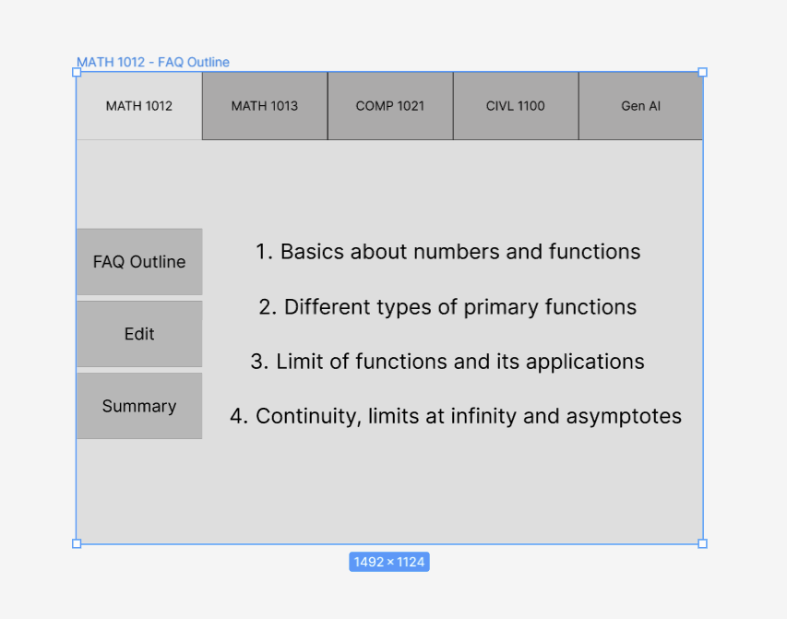
Assignment 4: Start making it! - Prototype and Project Plan
Prototyping and testing plan for the next iteration: Based on the feedback from this first prototype, plan what to improve, what to further test, with whom, and when. The plan should be practical within the course.
Plans of improvement in 2nd prototype:
Using GUI to make the process intuitive and user-friendly
Improvement in user journey to avoid duplicated actions
Consider users in PC, phones and tablets
Allow direct access of FAQ without using GenAI
Testing Details:
3-5 UG students, and 2-3 PG TA
Test whether GUI is intuitive to navigate and other desirable features
Dependency after UI development, planned 8-13 Nov
Current Progress of 2nd prototype in Figma:
(Only the interaction, but not yet the visuals)
https://www.figma.com/file/isaETt2Fy2ZOuMoGDFCIC
4/UI-prototype?type=design&node-id=4%3A10&mode=
design&t=fwiAOJeob6BTOQRu-1
Fig. 9: Current progress of GUI prototype in Figma

Slide 26
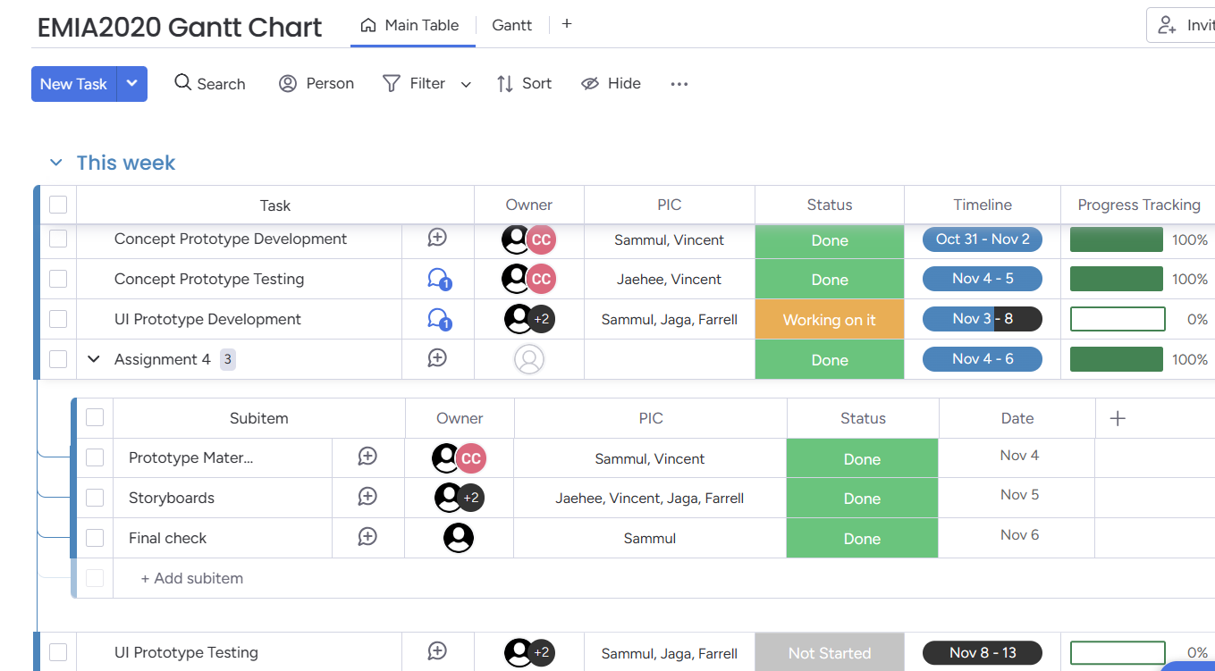
Assignment 4: Start making it! - Prototype and Project Plan
Gantt Chart and Members' Task Allocation
Fig. 10: Team's Gantt Chart in Monday.com

Slide 27
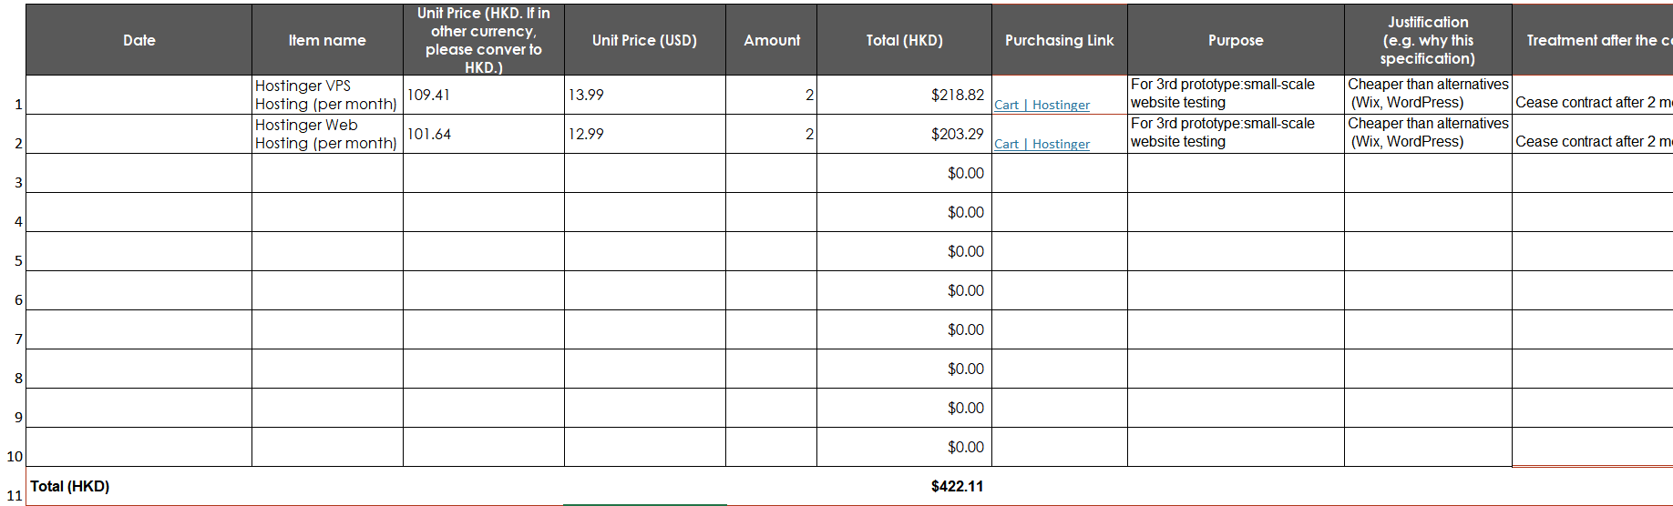
Assignment 4: Start making it! - Prototype and Project Plan
Part 6: Budget plan
Use the .xls template to provide your project budget plan. Read through the instructions carefully! If you don’t have anything to purchase, fill N/A. Take a screenshot of the budget breakdown table and show it in this section. Upload the .xls file to Canvas.

